Slide 1


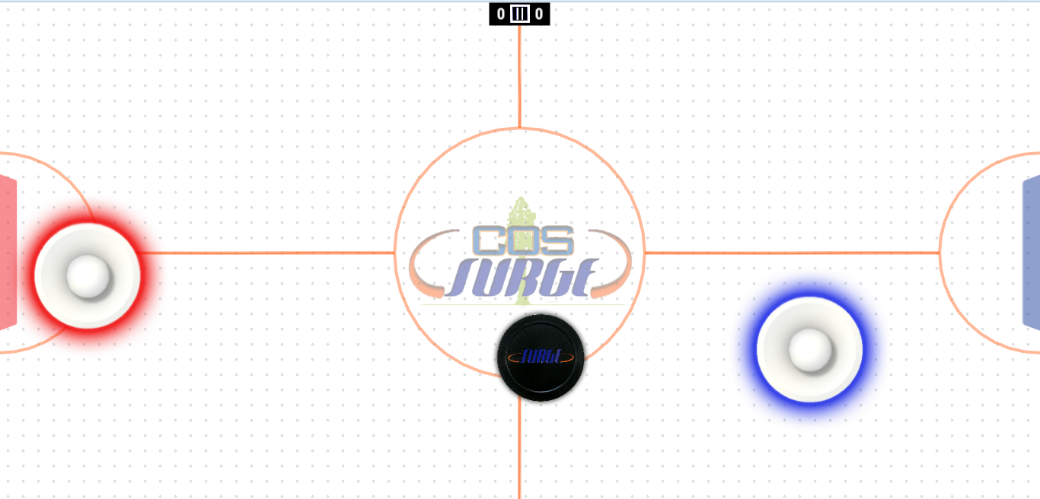
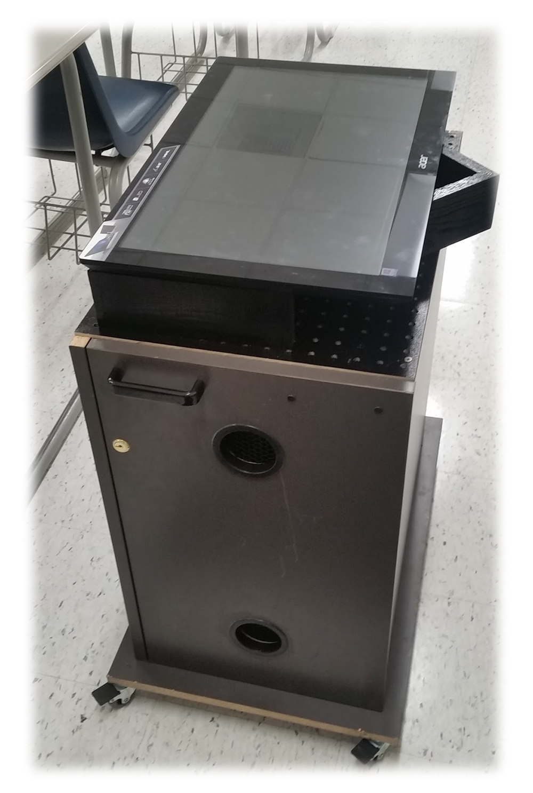

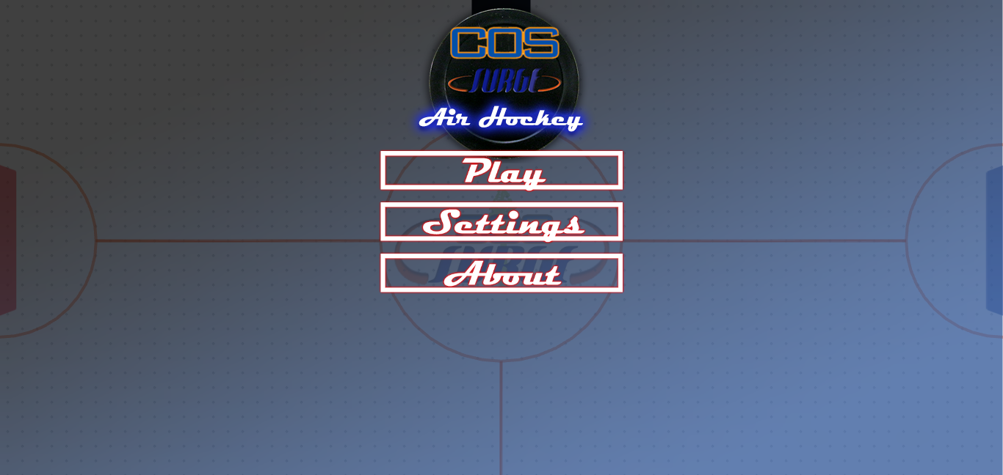
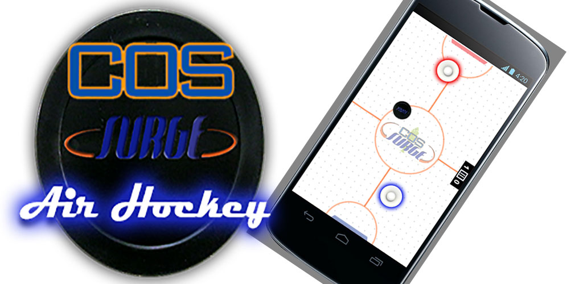

Game Table & Air Hockey Game Cory Lewis, Paul Gonzalez-Becerra , Gerald Jumper, Martin Garcia, Matthew Machado, Frazier, Graham
¹College of the Sequoias, & California State University, Fresno
²College of the Sequoias & California State Polytechnic University, Pomona
³Natural Resources Conservation Service, United States Department of Agriculture
Air Hockey Game Table
Multi-Purpose Game Table
GOAL: Design and build a multi-touch air hockey game table.
This project consisted of two components, building the game table and a mobile friendly air hockey application. Further requirements were that the game and screen must accept multiple inputs and be mobile friendly.
Building the Game Table: The project required design, research, hands-on building, and testing physical components needed to make the multi-touch system function properly.
Coding the Game: This project required programming from the ground up using a Javascript game engine and mobile app compilers. Design considerations required functionality on the Android operating system and the Chrome web browser.
Built Gaming Computer
Repurposed Table from the Tulare County Surplus Store
Design Tilting function on table
Test Touch system
Air flow designs
Mobile friendly
Designed to support VR functionality
Game Testing
Mobility Testing
Components Used in Design
Phaser.js
HTML5 Game Engine
IntelXDK
Compiles HTML5 game to an APK file
Emulates Android devices (for testing)
GitHub
Syncs changes to multiple developers
Allows project to be accessed by users to test
Photoshop
Create art for game
Open Source Project
Challenges
There were several challenges that we confronted and solved.
Design a physical table with tilting monitor assembly.
Research cost effective multi-touch screens.
Optimize and install a graphics card that can run a large multi-touch screen.
Consider height and mobility of cart for future use cases.
Program a singleplayer’s AI with difficulty levels.
Importing sound and music files while lowering load times.
Switching seamlessly between portrait and landscape mode.
Ensuring that the game was mobile friendly and optimized for the Play store.
Working with a large group.
Search “Air Hockey SURGE”
Acknowledgements
Special thanks to: The SURGE Program, John Redden, Dr. Lawrence Owens, Duane Goodwin.
Funding for this project was provided by the College of the Sequoias SURGE program, which is funded by the US Department of Education MSEIP grant #P120A130106.

